Slide 1


BLUINO A real time assistant for visual impairment….

Slide 2
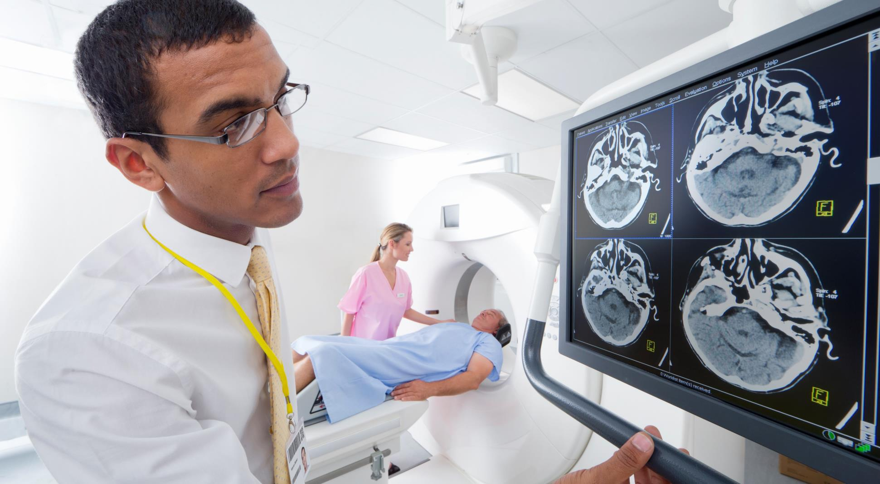



Content
Problem Statement
Introduction
Bluino & It’s Idea
Approach / Tech-stack
Working
Real Life Application
Frequent Errors
Conclusion

Slide 3

Problem statement .
People with visual impairment are part of our society who have the same rights as a citizen which has limited mobility. Arduino is a microcontroller-based technology that can be used as walking assistance. We here by propose ‘Bluino’ as walking support for visual impairment students.

Slide 4
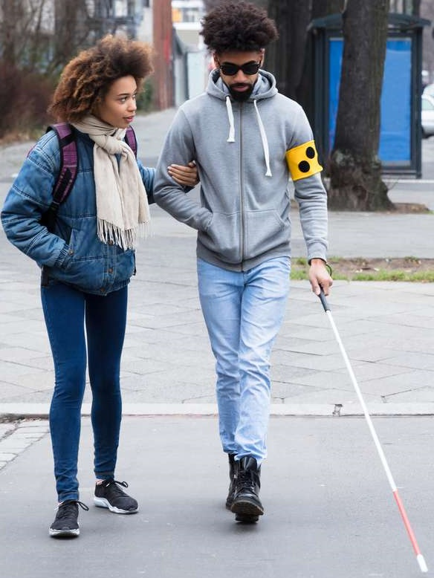
introduction
In life, we will never get perfection, including about the human birth with disabilities are also part of our society who have the same rights as a citizen.
One example of disabilities are people with visual impairments.
They are a part of society that has limited mobility in an
environment and social life.
People with visual impairments, when they will go somewhere, they have to be accompanied by someone as a navigator or using a stick which facilitates them to their destination.

Slide 5
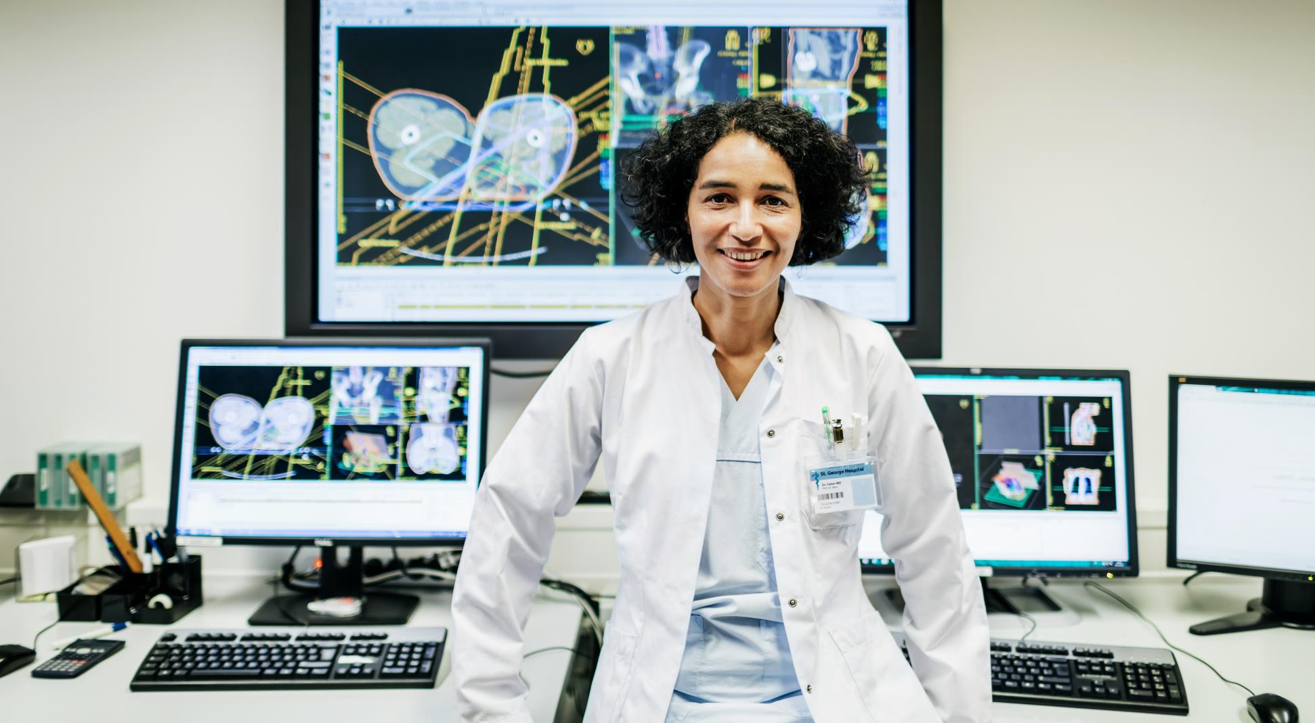
Bluino & it’s idea
People with visual disabilities suffer a lot in current time. As we see ourselves as prime example in it, we have to use spectacles or contact lenses to increase our visual prowess but there is not any useful thing for visually impaired people.
We hereby propose ‘Bluino’ as walking support for visually impaired students. It is equipped with an ultrasonic sensor HC-SR04 to detect an object approx 100 cm in range, which will trigger the buzzer to produce sound.

Slide 6
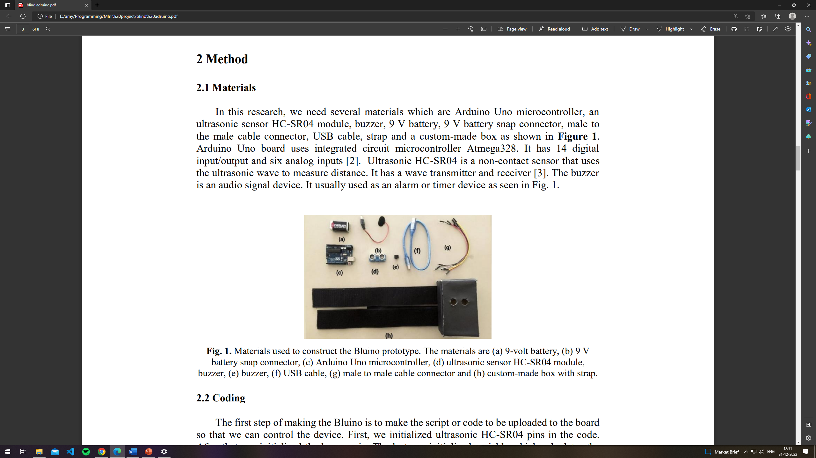
tech-stack / flow of development
The technology used is IOT(Internet of Things), describes physical objects with sensors, processing ability, software and other technologies that connect and exchange data with other devices and systems over the Internet or other communications networks.
Instruments used are :-
9 Volt Battery
Snap Connector
Arduino Uno R3 ATmega328P
Ultrasonic Sensor HC-SR04
Buzzer
USB Cable
Male to Male Cable Connector
Cap

Slide 7
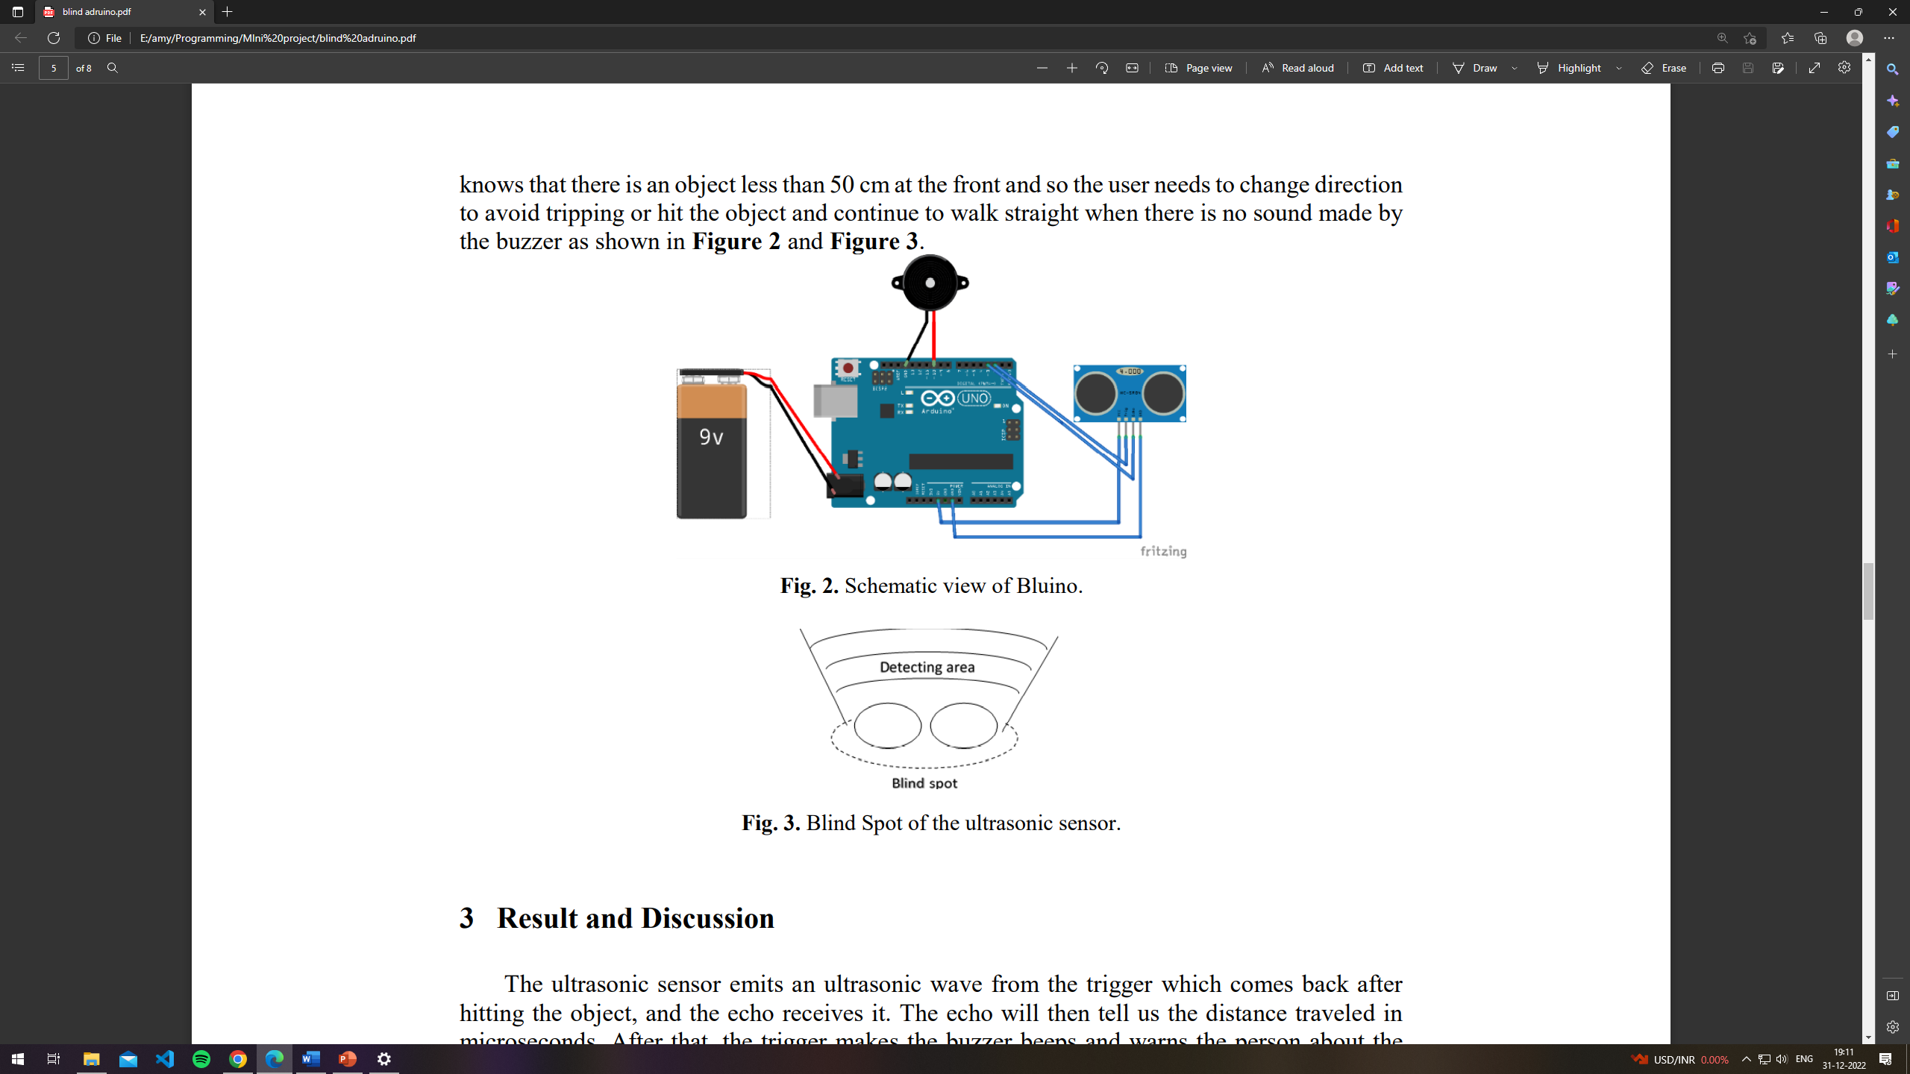

working
First step of making, Bluino is to design the code that has to be uploaded to the board through IDE, So that we can control the device. So, we initialized ultrasonic HC-SR04 pins in the code then initialized the buzzer pin and in last we initialized variable which calculates the distance of the objects.

Slide 8
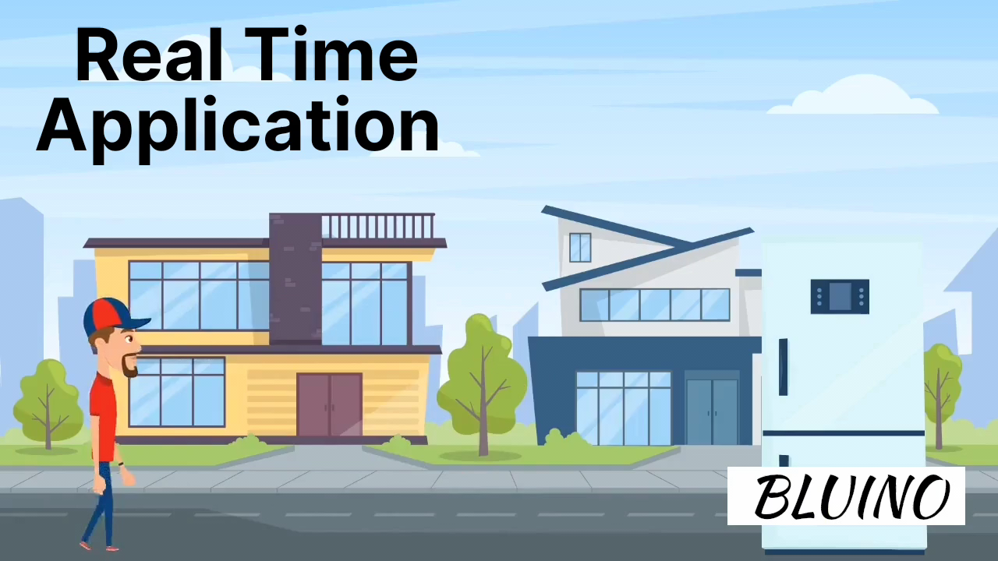

Slide 9

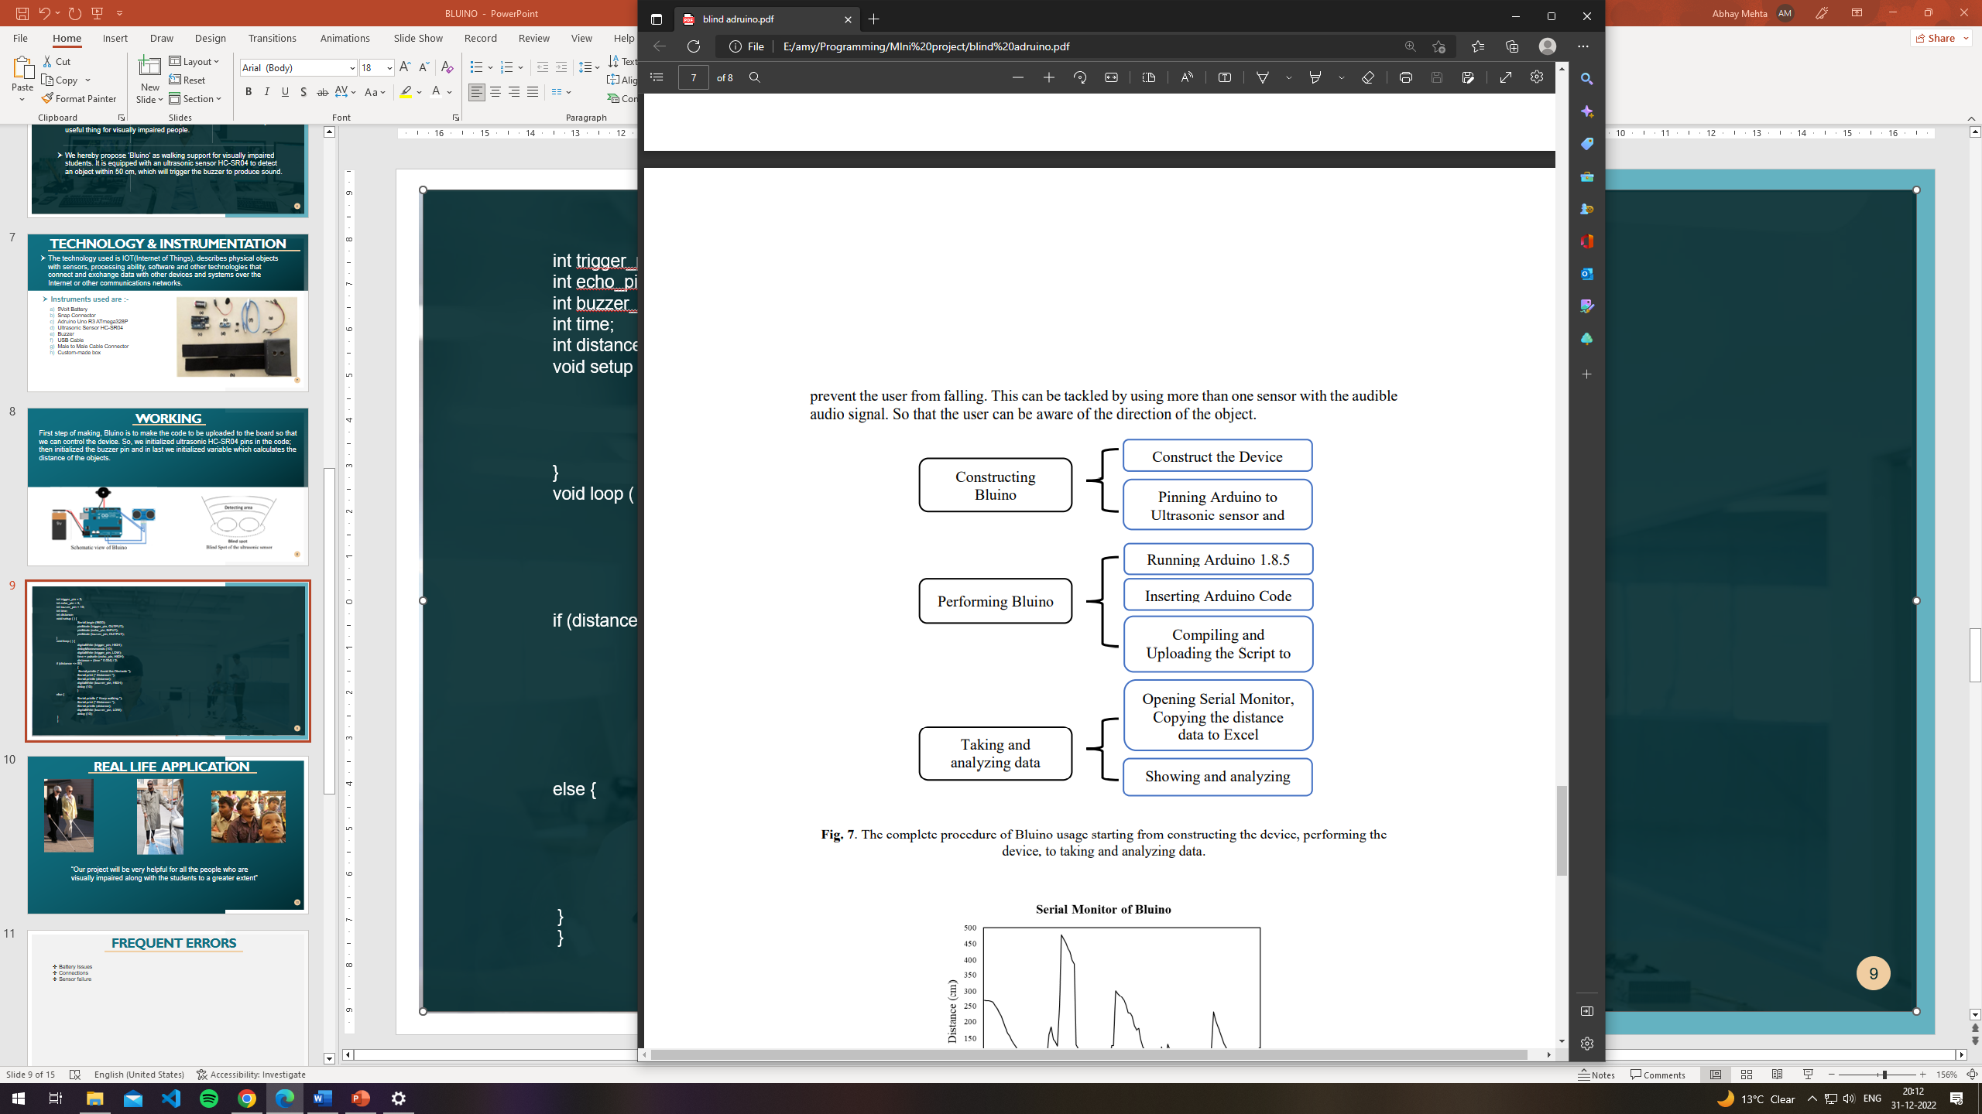
This Arduino Project is
developed in 3 phases :-
PHASE 1:
Here all the components related to this project are
assembled and pinned together and the construction
of device took place.
PHASE 2:
In this phase the software implementation of the project
took place and hence the algorithm is designed to make
the Bluino functional and therefore took the help of
Arduino IDE software.
PHASE 3:
Here comes the final stage of our project and now we
can connect serial monitors that helps us to show the
graph and analytics of the Bluino when working
although this is a developing stage of our project.

Slide 10
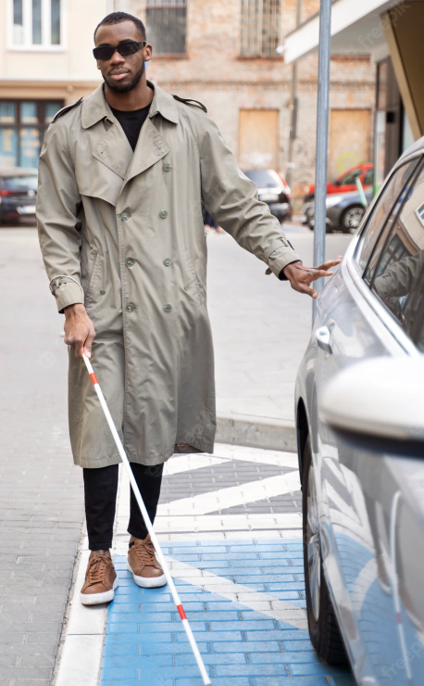
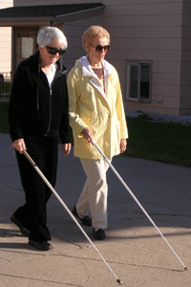
Usp & scalability of solution
Implementing with the help of Arduino Nano board to reduce it’s size to make it more user friendly.
Making it more Affordable and Effective for visually impaired people.
Implementing the BLUINO model in form of Body Kit for wide range of obstacle coverage.

Slide 11
FREQUENT ERRORS
Battery Issues
Connections
Sensor failure

Slide 12

conclusion
Bluino can be very helpful for visually impaired people by using the ultrasonic sensor to detect object distance and send an audio signal to warn the user.
Bluino itself has a simple schematic scheme, so it easy to make customizations according to the user or customer.
This is just a prototype, we are working on it to make it work in a bigger picture with more exactness for the visual impaired people.

Slide 13

Thank you

